Slide 1
Summary & Wrap-up
Source of most materials:
Xiwei Xu, Ingo Weber, and Mark Staples. Architecture for Blockchain Applications. Springer, 2019

Slide 2
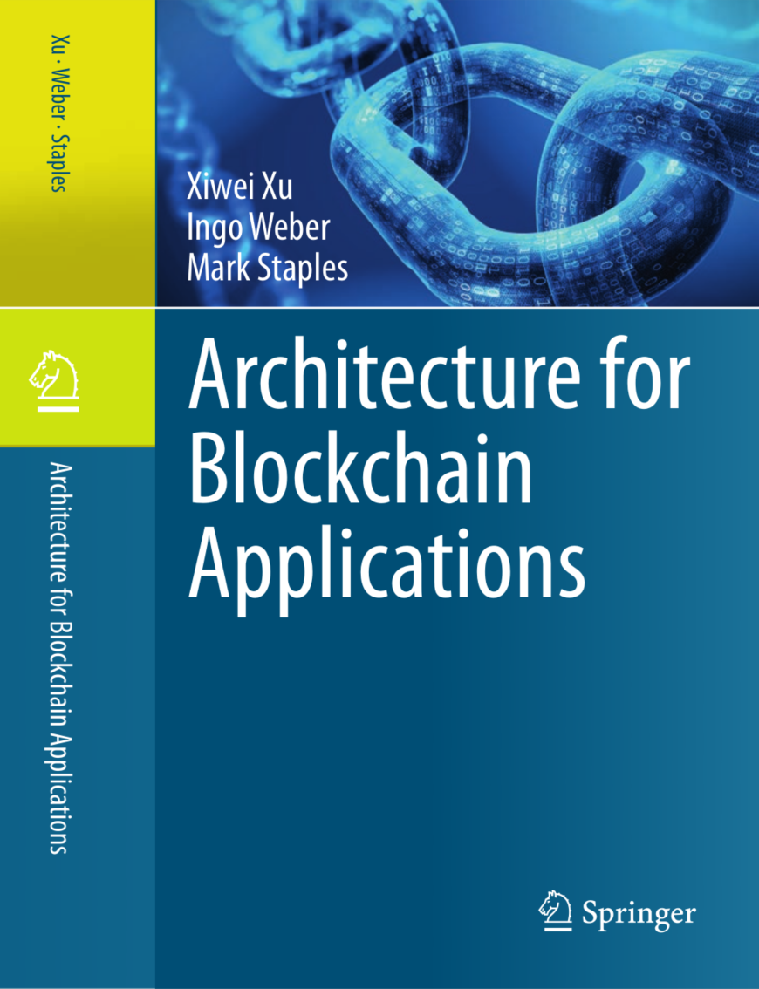
Book for this lecture: Architecture for Blockchain Applications
Xiwei Xu, Ingo Weber, Mark Staples.
Architecture for Blockchain Applications.
Springer, 2019.
Available as e-book through UB, while connected to TU network
In many cases, the book contains more detail about a concept than the slides

Slide 3
Course Summary 1/3
1. What is blockchain? Why does it matter?
Definitions
Role in Software Architecture
How it’s different
2.-5. Existing blockchain platforms
Cryptography basics
Nakamoto Consensus, PoW
Bitcoin
Script, UTXO
Ethereum
Solidity, Gas
Smart contract capabilities
6. Example use cases
7.-11. Blockchain in Software Architecture
Taxonomy
Blockchain properties & limitations
Software Architecture basics
What is Software Architecture
Non-Functional Properties and Design Tradeoffs
Views/Viewpoints; ATAM
UTXO vs Accounts
Arbitrary data storage
Is blockchain suitable?
Design Process

Slide 4
Course Summary 2/3
12. Cost
Trade-offs between NFPs
Cost drivers for storage & computation
13.-14. Performance
Load × Resources → Performance × Utilisation
Latency vs Throughput
Latency for Transaction Inclusion
Options for Latency & Throughput in Blockchain-Based Applications
15.-16. Dependability & Security
Faults, Errors, Failures
Trust, Trustworthiness, Assurance
Functionality
Specification? Code is Law?
Integrity, Confidentiality, Privacy, Non-Repudiation, Accountability, Authenticity
Reliability, Availability

Slide 5
Course Summary 3/3
17.-18. Design Patterns
Interaction with external world
Data management
Security
Contract structure
Deployment
19. Model-Driven Engineering
Models for Data & Tokens
Models for Business Process
Generation & Execution
Workflow on Blockchain

Slide 6
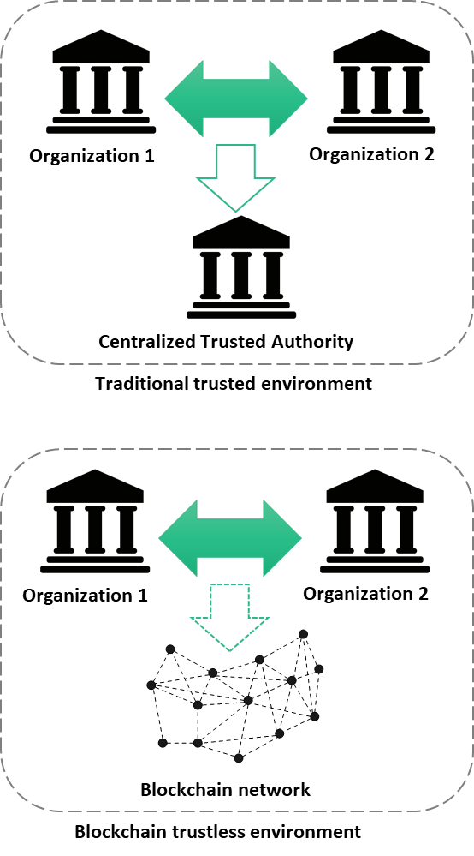
What is blockchain? Why does it matter?
You should know what these things are:
Blocks, Ledgers, Transactions
Nodes, Miners
Cryptocurrencies, Tokens, Digital Assets
Private vs Public Blockchains, vs. DLT
Smart Contracts
Oracles
Dapps / Decentralised Applications
Blockchain-Based Applications

Slide 7
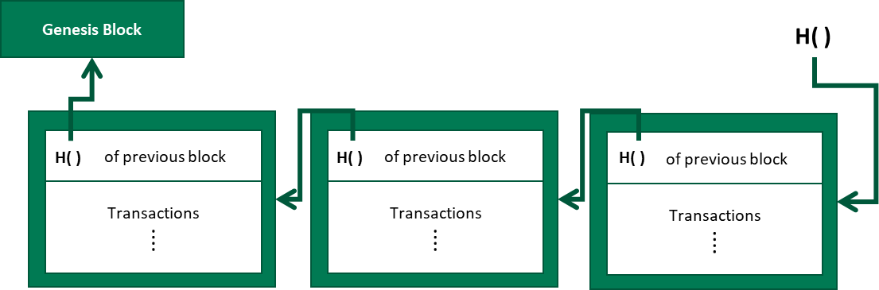
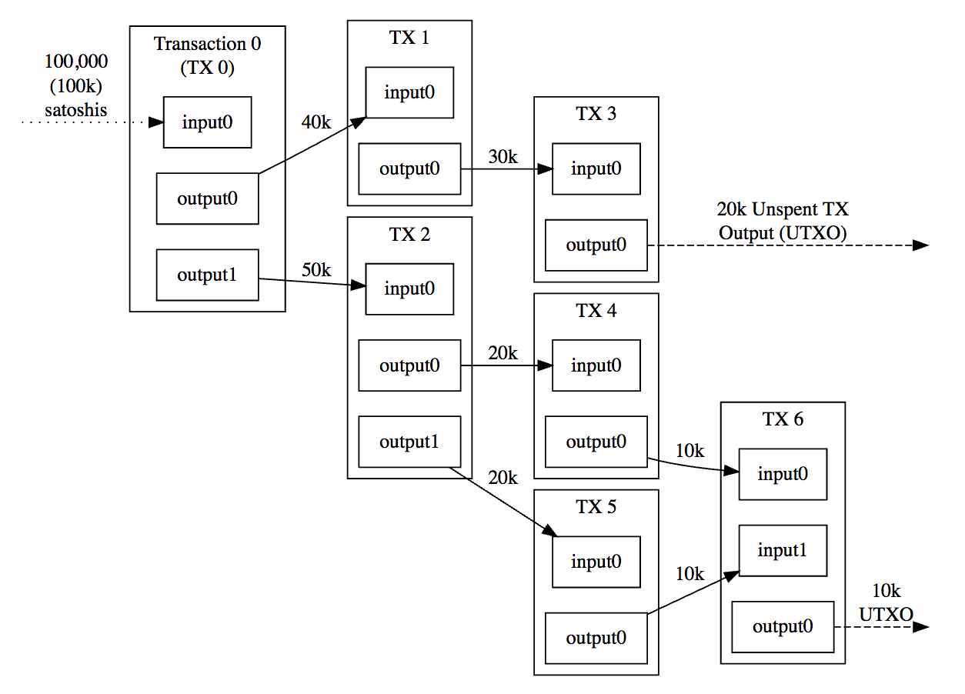
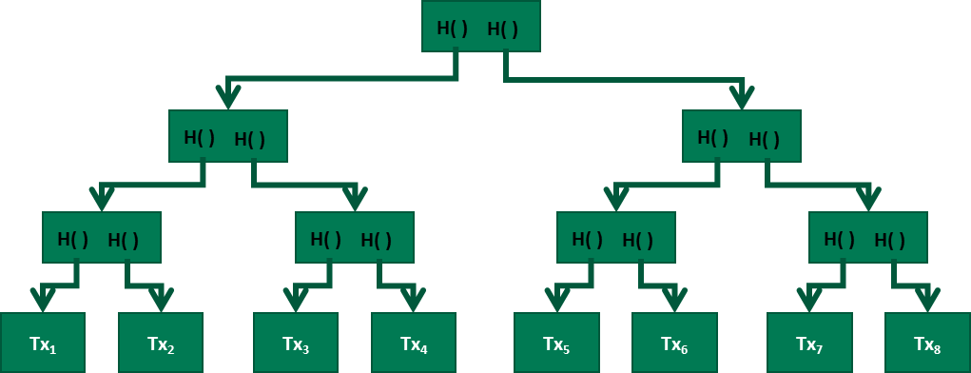
Bitcoin: Blocks-in-Ledger vs. Transactions-in-Block vs. UTXO

Slide 8
Ethereum Transactions & Smart Contracts

Slide 9
Blockchain Taxonomy Dimensions
(De)centralization
Deployment
Public vs. Private
Ledger Structure
List vs. DAGs vs. Networks of Ledgers
Consensus Protocol
Block Configuration and Data Structure
Auxiliary Blockchain
Merged mining, sidechains, entangled, sharding,
Anonymity
Incentive
Notes:
8 dimensions to classify blockchain variants

Slide 10
ISO/IEC 25010:2011 Quality Model
Functional suitability
Functional correctness
Functional complete-ness
Performance efficiency
Capacity
Resource utilization
Functional appropriate-ness
Time behavior
Compatib-ility
Interop-erability
Co-existence
Usability
Operability
User error protection
Reliability
Availability
Recoverab-ility
Maturity
Fault tolerance
Security
Integrity
Confidential-ity
Non-repudiation
Accountab-ility
Authent-icity
Maintain-ability
Modularity
Reuseability
Modifiab-ility
Testability
Analyzab-ility
Portability
Installability
Replace-ability
Adaptability
Notes:
International standards for evaluation of software quality
Blockchain has good and bad quality

Slide 11
Software Architecture
Non-Functional Properties arise from Architectural Design Choices
Choose your design,
Choose your trade-offs

Slide 12





Not Stand-Alone; Design to Resolve Tradeoffs
Non-Functional Property Trade-offs
(+) Integrity, Non-repudiation
(-) Confidentiality, Privacy
(-) Modifiability
(-) Throughput/ Scalability/ Big Data
(+ read/ - write) Availability/ Latency
Legacy
systems
UI
Key
management
Blockchain is a component
BIG DATA
IoT
private
data
Auxiliary
databases

Slide 13
Blockchain in Larger Software System
Applications
Applications
Applications
Applications
API
Key Management
Tokens/ Currencies
Smart Contracts
Private Data
Key Management
Shared Data Ledger (meta-data, small data)
Big Data
Key Management
Component
Auxiliary
Database
Blockchain
Notes:
The blockchain stores and shares data, and executes smart contracts.
The blockchain component might also control digital currency or represent other assets.
Due to limitations of privacy and scalability, there are also off-chain auxiliary databases used in the system.
First, private data is stored in an internal database. Second, large data is stored separately, such as in a cloud service.
There is an API layer between the three data storage mechanisms.
Key management is an essential component when working with blockchains. Every participant in a blockchain network has one or more private keys, which are used by the participant to digitally sign its transactions.

Slide 14
Blockchain As An Architectural Element
Functions:
Storage
Shared append-only store of transaction data
Computation
Smart contracts as little programs
Communication
Asset Management and Control

Slide 15
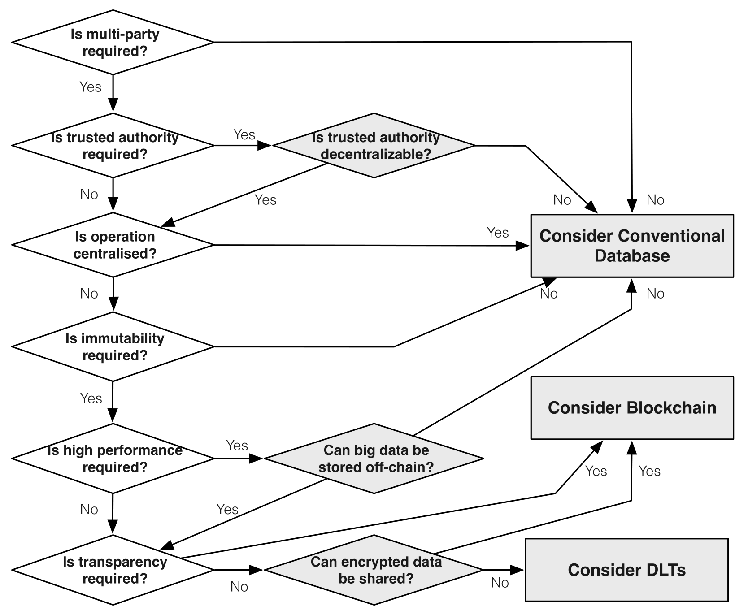
Suitability Evaluation Framework
Notes:
This is the flow to evaluate the suitability of blockchain technology
There are 6 main questions to be answered, shown as white diamonds.
Some of the questions have follow-up question as shown in grey diamonds.
We will discuss these questions one by one in detail.

Slide 16
Design Process
Every step is a procedure to decide between alternative options
Taxonomy in Lectures 7 & 8
Systematic comparison of different design options
Notes:
The available options discussed in Lecture 3are used to assist decision-making and to guide the system design at different stages of the design process.
This enables a systematic comparison of the capabilities of different design options.

Slide 17
Cost
Cost of basic compute and storage on public blockchain have different cost structure than conventional cloud
One-off costs vs ongoing costs
But, public blockchain overall is orders of magnitude more expensive
For public blockchain, cost model should include exchange rate
Highly volatility cryptocurrency exchange rates
Cost tradeoffs with other non-functional properties
Maintainability and Scalability
Price of avoiding centralize control of data and computation

Slide 18
Transaction Inclusion Time in Public Blockchain…
mining
mining
Timeline
(not to scale)
t0 start mining on previous candidate block
t1
Tx sent
t2
miner includes Tx in candidate block
t3
Tx is observed in new mined block
interblock time / 2
+
interblock time

Slide 19
Latency of Process Execution on Public Blockchain
Here, the design does not use confirmation blocks.
Quick & dirty!
Assumes averages (median or mean)!
Transactions arrive in the middle of an interblock time window
Uniform average interblock time
1.5 x interblock
+ 2 x interblock
+ activity duration + 1.5 x interblock
(First Activity)
(Fast Automated Response)
(Slow or Manual Response)
…
The first activity will arrive in “the middle” of some interblock time window, so takes 1.5 x interblock times.
If activity response is very fast (in the same interblock time window), it will still be too late to include in the next block, so will take 2 x interblock times.
If the activity response is very slow (longer than the interblock time window), it will arrive in “the middle” of some future interblock time window
Notes:
our research group studied the possibility of using blockchain for collaborative business process in order to address the lack of trust problem in collaborative business process.
The idea is to use blockchain and the smart contract functionality to enforce the trustworthiness of the process without having a centralized trusted third party.
In the proposed method, blockchain facilitates collaborative process either of two ways; as a choreography monitor which stores the process execution status and provides immutable data storage or active mediator by coordinating the collaborative process.
smart contracts in a blockchain can not interact directly with the external world, a trigger component connects the processes executing on blockchain to enterprise systems by acting as an agent for an organization. The trigger manages keys, keeps track of the data payload in API calls, and can interact with external services including other databases or web services.
Generally each organization has to deploy it’s own trigger and at least one blockchain full node connected to the blockchain.

Slide 20
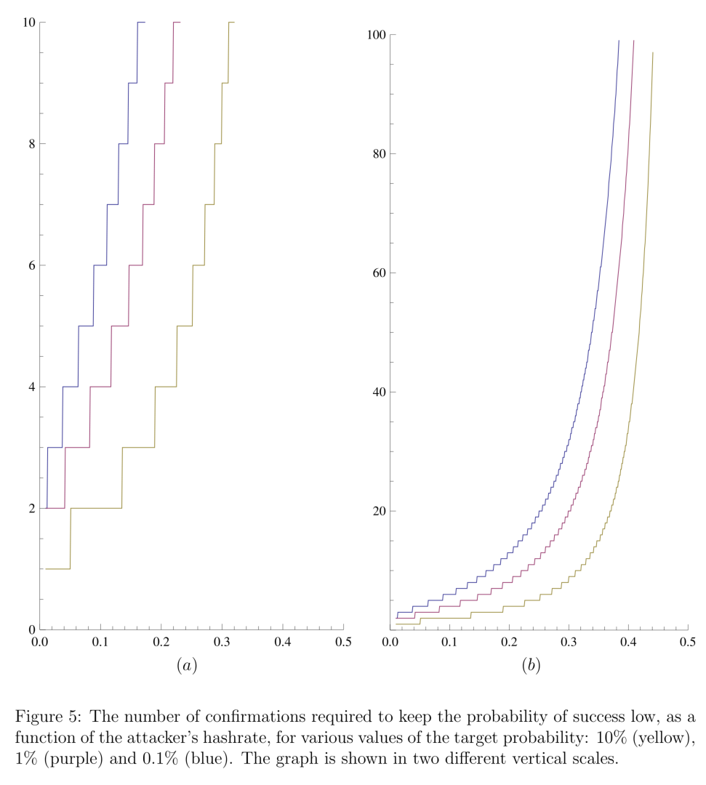
In Public Blockchains, Wait for Confirmation Blocks
Nakamoto consensus can create “uncle” blocks
Blockchains using Proof-of-Work, Proof-of-Stake, …
Transaction you saw in a block turns out not to have been officially included in the blockchain
Only probabilistic, long-run, transaction inclusion
Can increase confidence your transaction is really included, by waiting for subsequent “confirmation blocks”
For Bitcoin, often people say wait 6 blocks
For Ethereum, often people say wait 12 blocks
(Lower interblock time can increase likelihood of uncles)
Waiting for confirmation blocks increases latency, and increases latency variability
“Analysis of hashrate-based double spending”
https://arxiv.org/abs/1402.2009

Slide 21
Blockchains as Dependable Systems
Trust – accepted dependence
Trustworthy – justified Trust
Need Evidence to justify Engineering Assurances
Validation
Sort-of-but-not-quite: “am I solving the right problem?”
Does my requirements/specification/system/design address/solve the user problem?
Verification
Sort-of-but-not-quite: “am I solving the problem right?”
Does my system/design meet the requirements specification?
Can provide evidence based on architectural analysis, early in the lifecycle
Blockchains are increasingly relied on; need evidence they are trustworthy

Slide 22
ISO/IEC 25010:2011 Dependability & Security
Functional Suitability
Correctness
Completeness
Appropriateness
Code is Not Law
How to specify smart contracts?
Security
Integrity & Clark-Wilson policy model
Blockchain “anomaly” in Nakamoto consensus: possible transaction reordering
Confidentiality
And its difference to Privacy
Non-Repudiation
Accountability
Avoid or support? KYC/AML-CTF
Authenticity
Reliability
Availability: readiness for service
Affected by latency variability
Recoverability
Aborting transactions
“Maturity”
Reliability: continuous service
Fault Tolerance
Use of smart contracts for redundant oracles

Slide 23
Design Patterns 1/2
Interaction with External World
Data Management
Security
Centralized Oracle
Decentralized Oracles
Voting
Reverse Oracle
Legal and smart contract pair
Introducing external state into the blockchain environment through a centralized oracle
Introducing external state into the blockchain environment through decentralized oracles
A method for a group of blockchain users to make a collective decision
A method for a group of blockchain users to make a collective decision
A bidirectional binding between a legal agreement and the corresponding smart contract that codifies the legal agreement
Encrypting On-chain Data
Tokenisation
Off-chain Data Storage
State Channel
Ensuring confidentiality of the data stored on blockchain by encrypting it
Using tokens on blockchain to represent transferable digital or physical assets or services
Using hashing to ensure the integrity of arbitrarily large datasets which may not fit directly on the blockchain
Transactions that are too small in value or that require much shorter latency, are performed off-chain with periodic recording of net transaction settlements on-chain
Multiple Authorization
Dynamic authorization
X-Confirmation
Security Deposit
Transactions are required to be authorized by a subset of the pre-defined addresses
Using a hash created off-chain to dynamically bind authority for a transaction
Waiting for enough number of blocks as confirmation to ensure that a transaction added into blockchain is immutable with high probability
A deposit from a user, which will be paid back to the user for her honesty or given to others to compensate them for the dishonesty of the user

Slide 24
Design Patterns 2/2
Structural Patterns of Contract
Deployment
Contract Registry
Embedded Permission
Data Contract
Factory Contract
Incentive Execution
The address, and the version of the smart contract is stored in a contract registry
Embedded permission control is used to restrict access to the invocation of the functions defined in the smart contracts
Storing data in a separate smart contract
An on-chain template contract used as a factory that generates contract instances from the template
A reward to the caller of a contract function for invocation
Dapp
Semi-dapp
Blockchain-based application hosted on P2P network, with a website that allows users to interact with smart contracts
Blockchain-based application with a website that can be browsed using a conventional web browser without any dapp plugin

Slide 25
Model-Driven Engineering of Blockchain-Based Applications
Code generation for best practices and well-tested building blocks
Improved productivity, especially for novices
Models are often easier to understand than code
Can be independent of specific blockchain technologies or platforms
Avoid lock-in to specific blockchain technologies

Slide 26
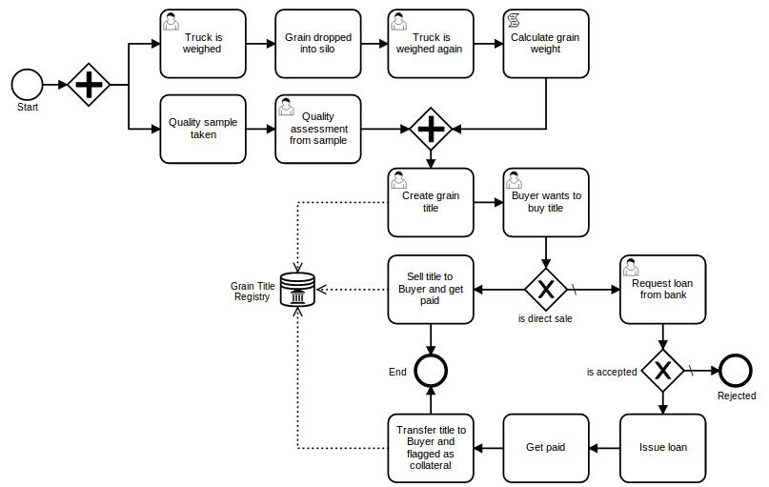
Combining process and data/token models

Slide 27
Learning Outcomes
Now you can:
Explain the principles of blockchain and which roles it can play in an application architecture
Decide on the suitability of blockchains and how to design applications using them
Make functional and non-functional trade-offs for blockchain-based applications
Build small applications on blockchain

Slide 28
Other Topics (not covered in the course)
Standards
Interoperability
Governance
Regulation, and the Law
CryptoEconomics
New Business Models

Slide 29
Summary & Wrap-up
Source of most materials:
Xiwei Xu, Ingo Weber, and Mark Staples. Architecture for Blockchain Applications. Springer, 2019

